Slide 1



Airlines Rating
View in Power BI
Last data refresh:
4/18/2024 5:05:50 AM UTC
Downloaded at:
4/26/2024 5:34:37 PM UTC

Slide 2
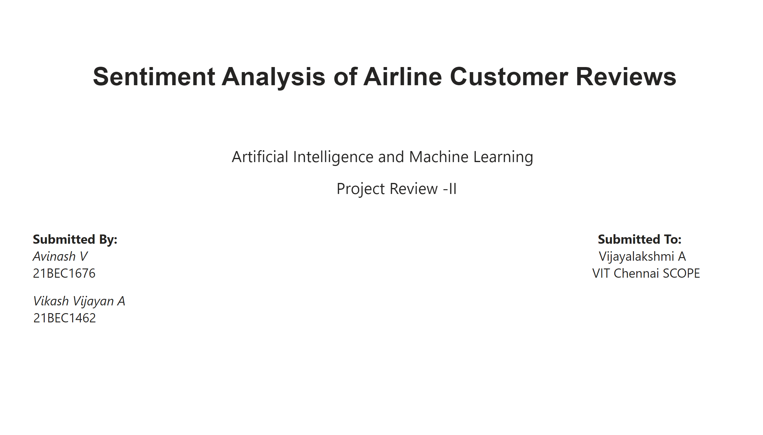
Page 1
Notes:
textbox
No alt text provided

Slide 3
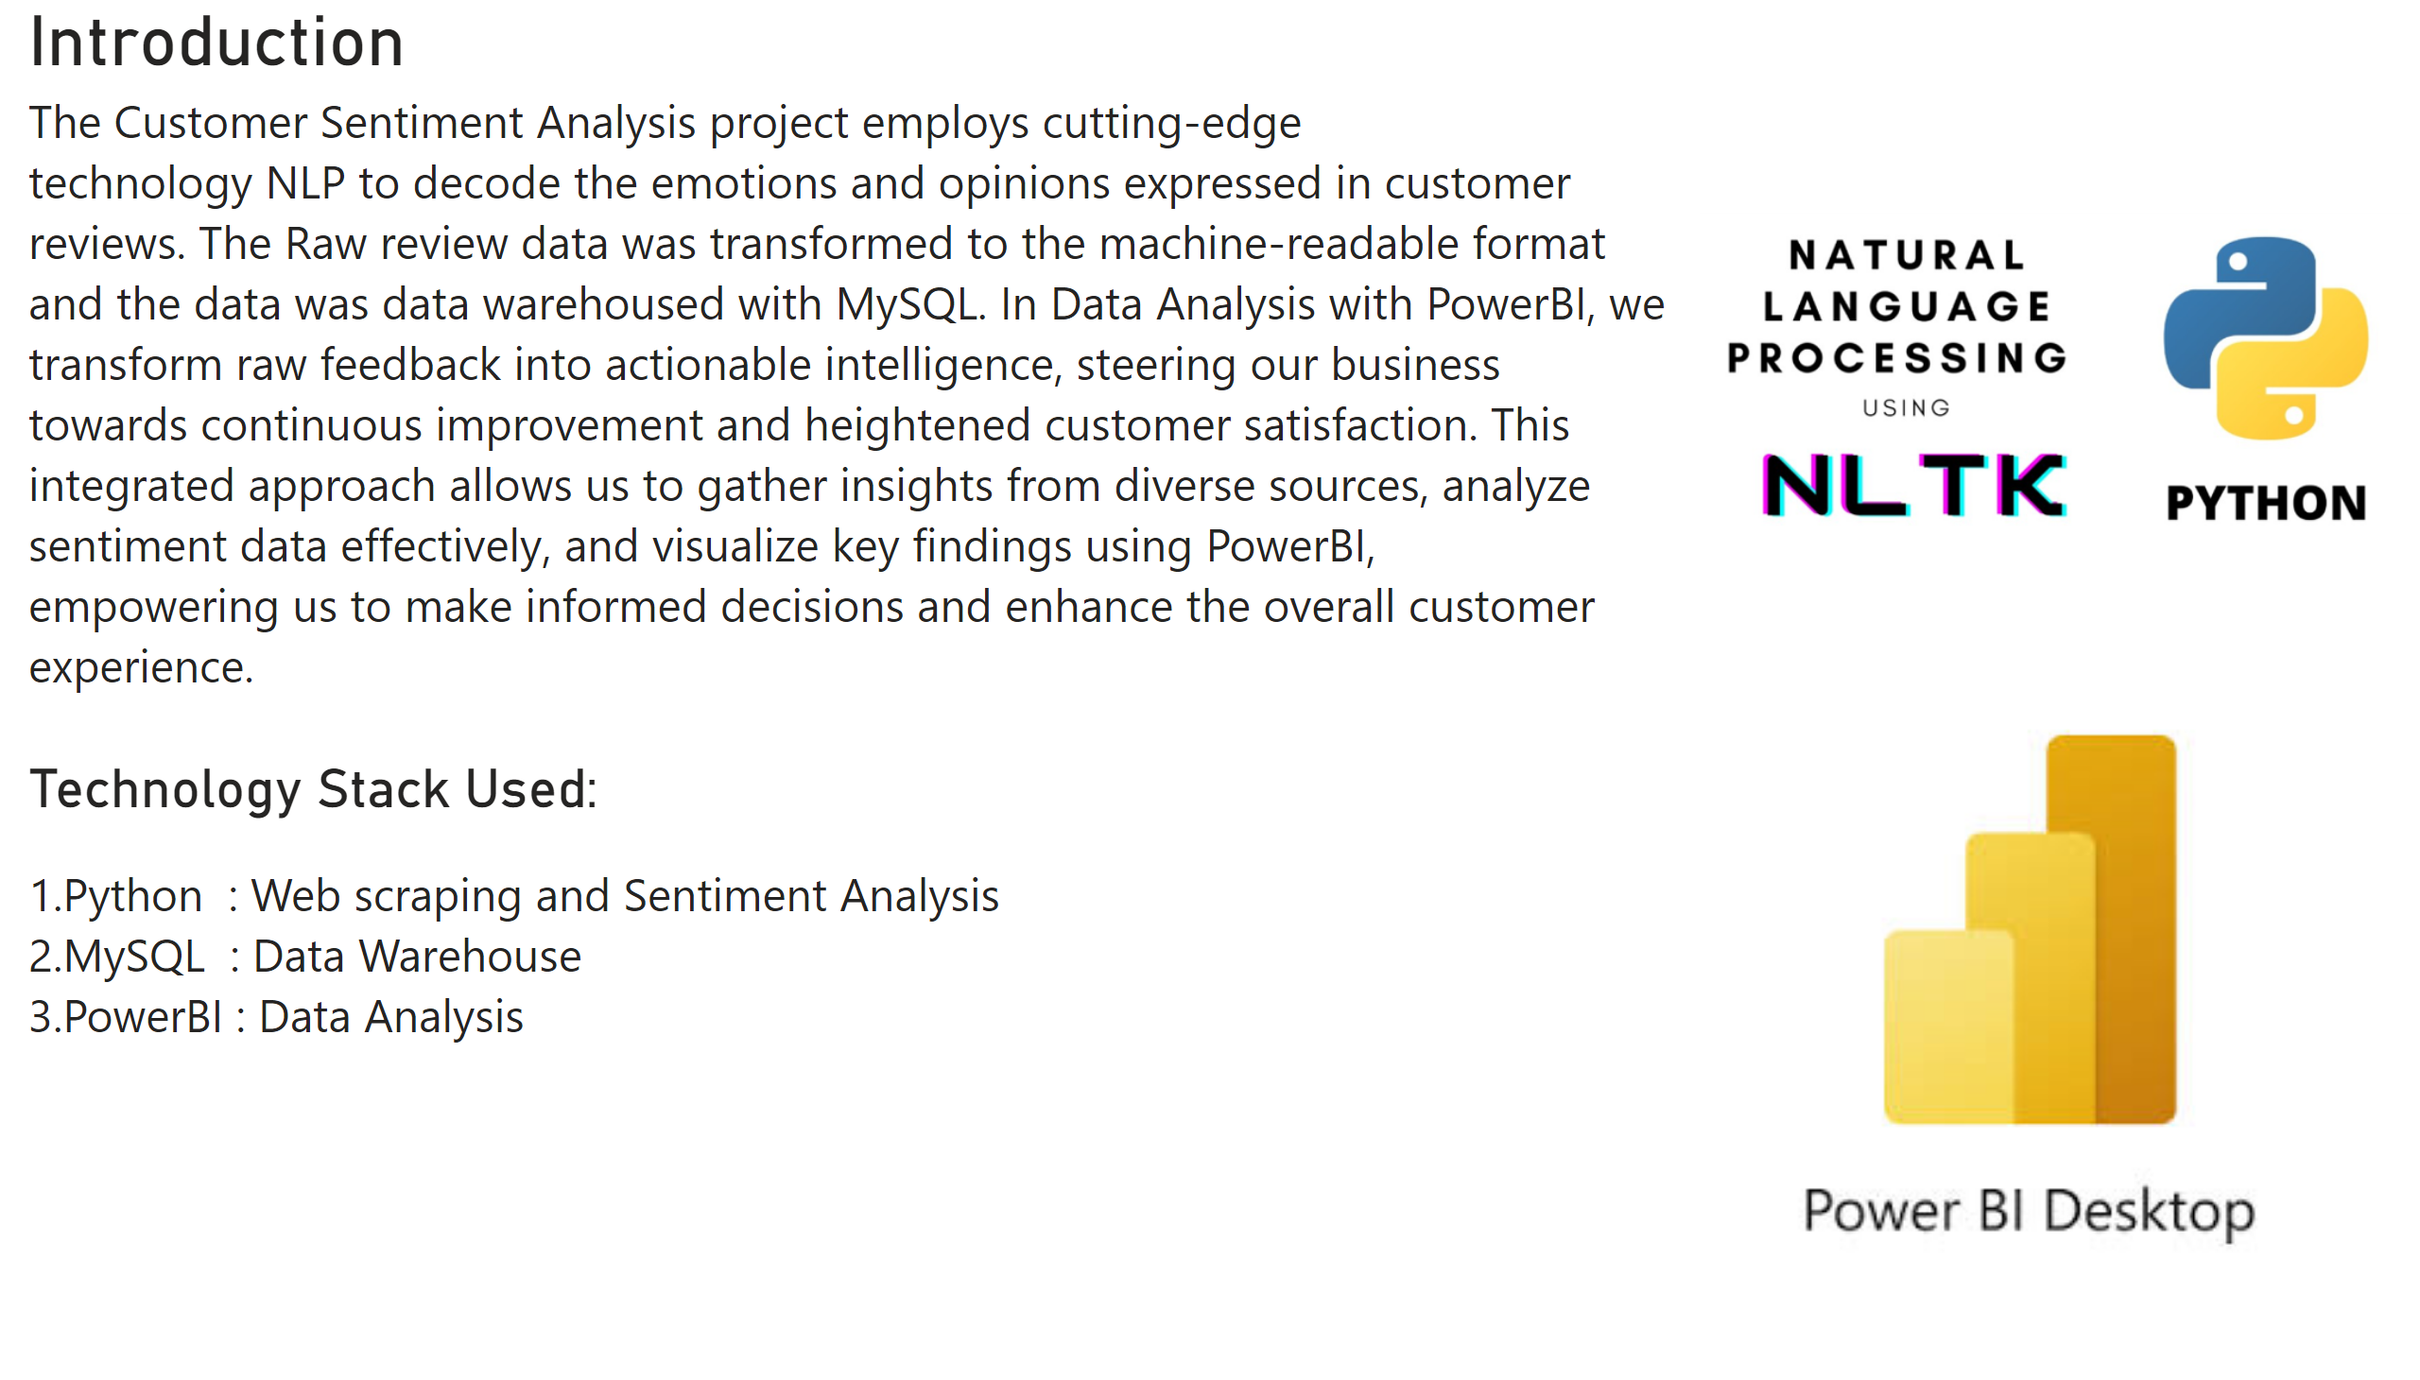
Page 2
Notes:
Introduction
No alt text provided
Technology Stack Used:
No alt text provided
image
No alt text provided
image
No alt text provided

Slide 4
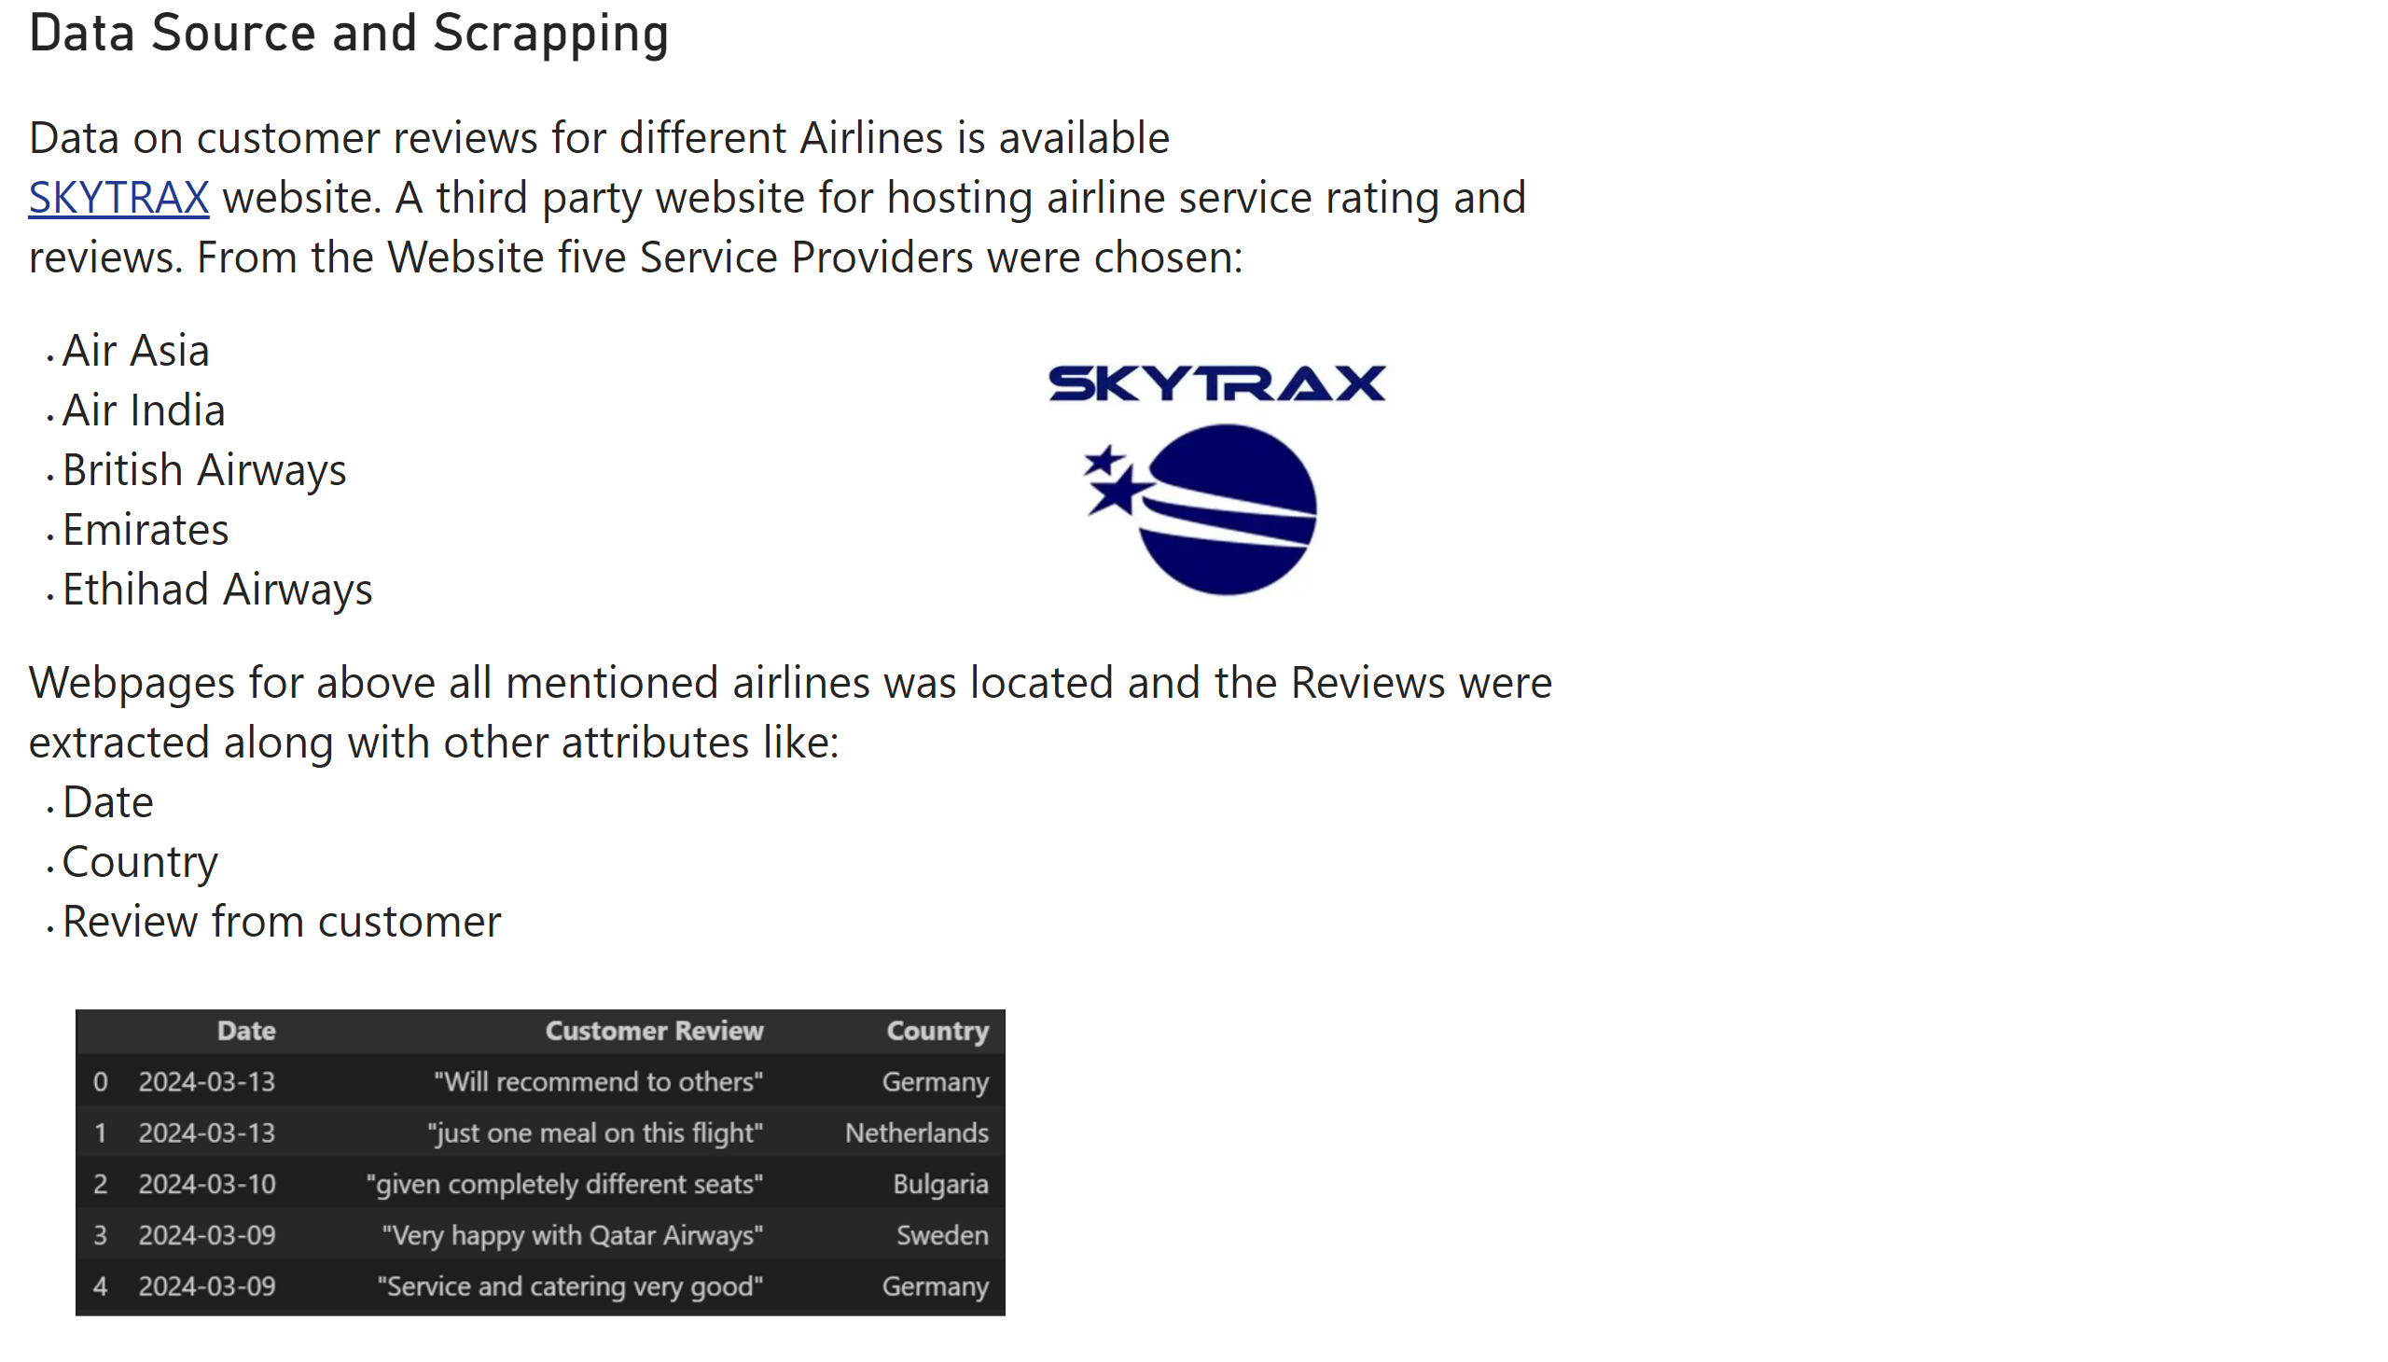
Page 3
Notes:
Data Source and Scrapping
No alt text provided
image
No alt text provided
image
No alt text provided

Slide 5
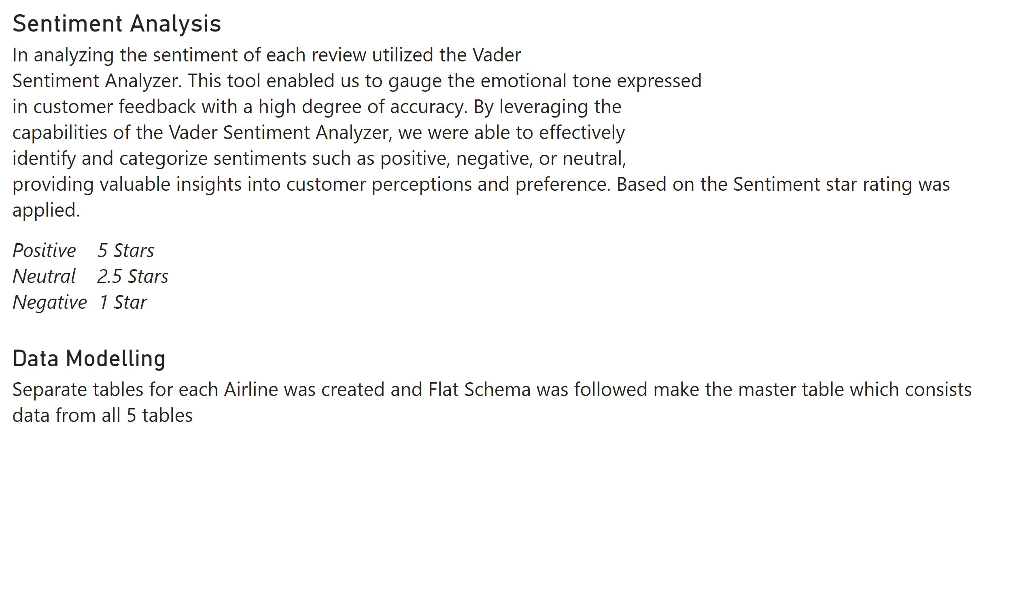
Page 4
Notes:
Sentiment Analysis
No alt text provided
Data Modelling
No alt text provided

Slide 6
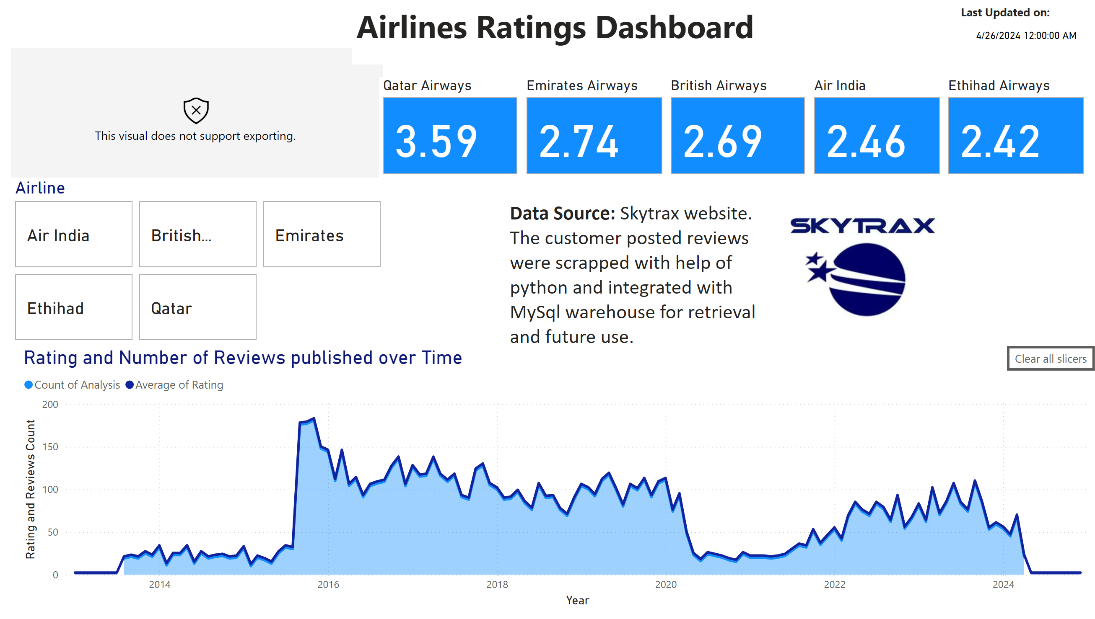
Page 5
Notes:
Rating and Number of Reviews published over Time
No alt text provided
ratingsvisual001
No alt text provided
advancedSlicerVisual
No alt text provided
actionButton
No alt text provided
card
No alt text provided
textbox
No alt text provided
textbox
No alt text provided
Air India
No alt text provided
British Airways
No alt text provided
Emirates Airways
No alt text provided
Ethihad Airways
No alt text provided
Qatar Airways
No alt text provided
image
No alt text provided
textbox
No alt text provided

Slide 7
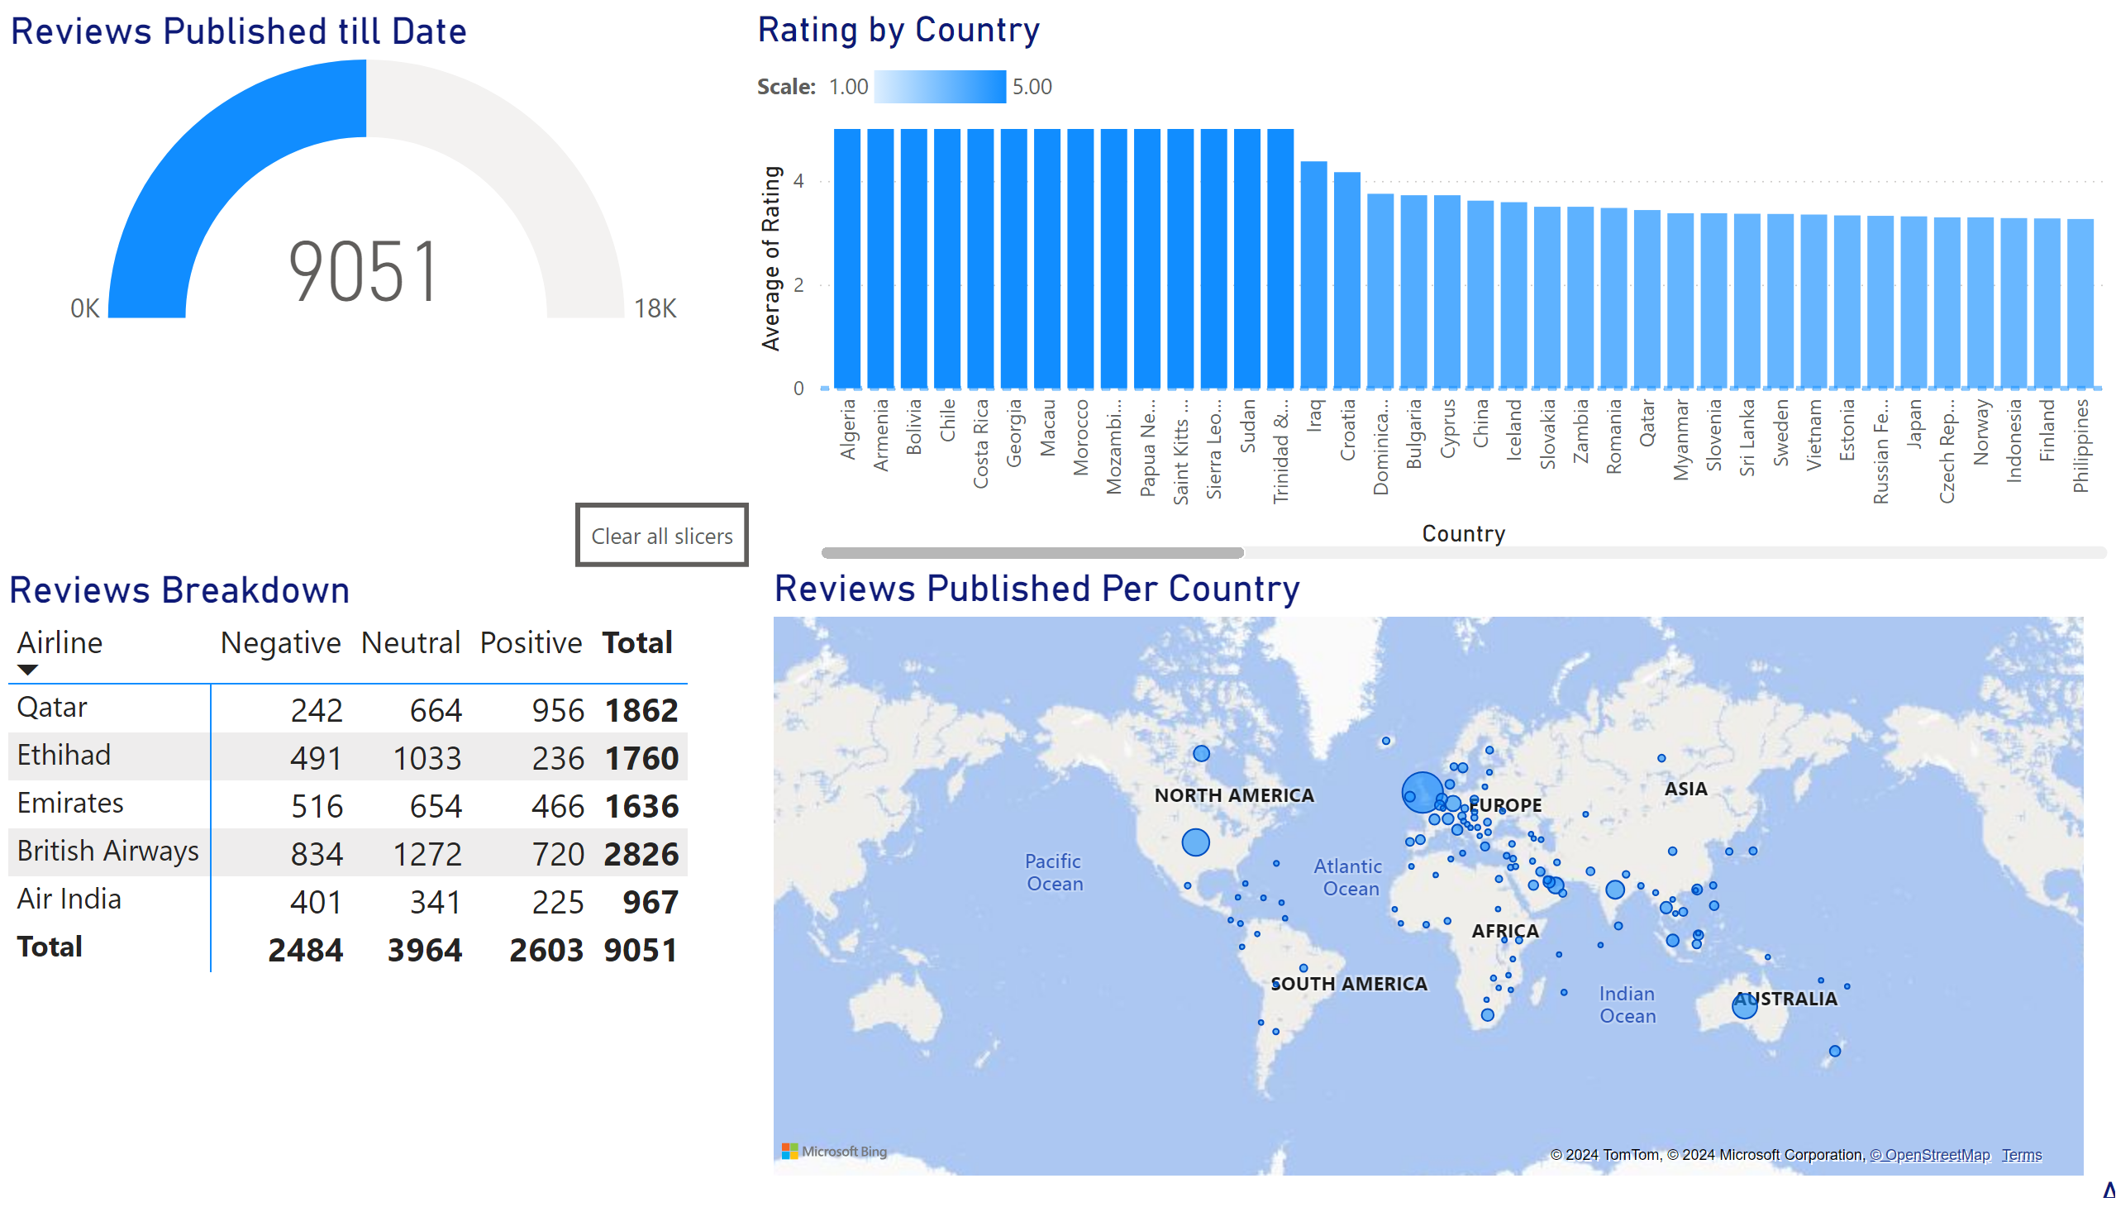
Page 6
Notes:
actionButton
No alt text provided
Reviews Published till Date
No alt text provided
Reviews Breakdown
No alt text provided
Reviews Published Per Country
No alt text provided
advancedSlicerVisual
No alt text provided
Rating by Country
No alt text provided

Slide 8
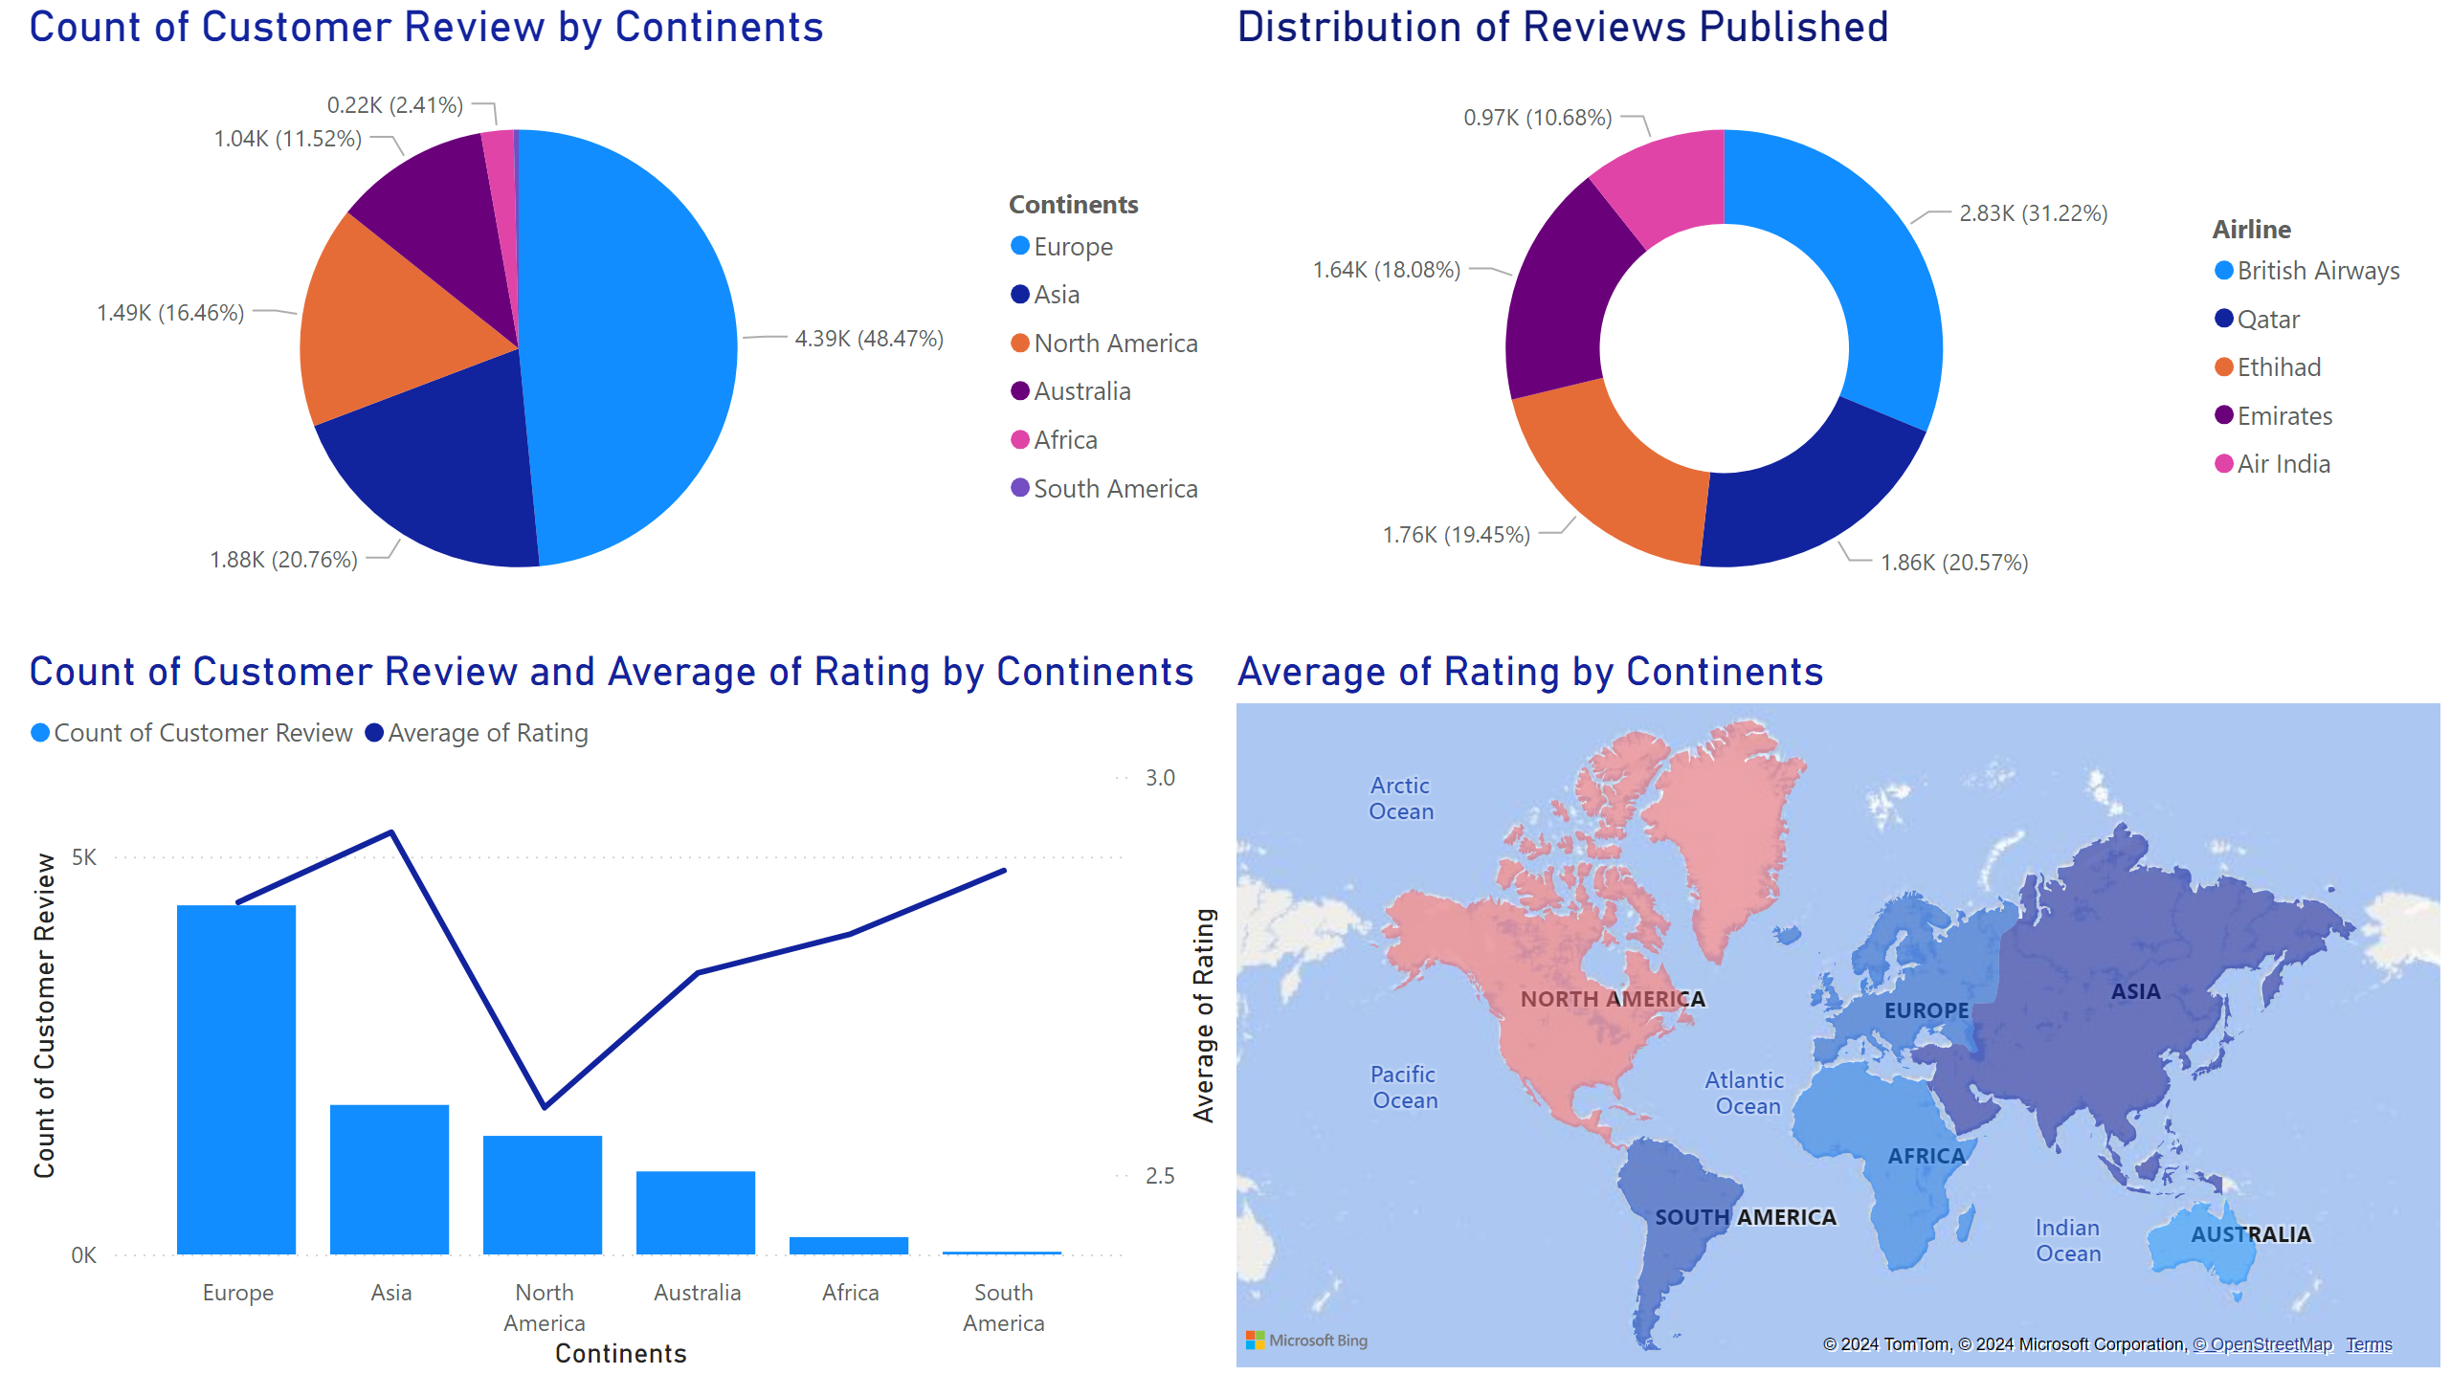
Page 7
Notes:
pieChart
No alt text provided
Distribution of Reviews Published
No alt text provided
lineClusteredColumnComboChart
No alt text provided
filledMap
No alt text provided

Slide 9
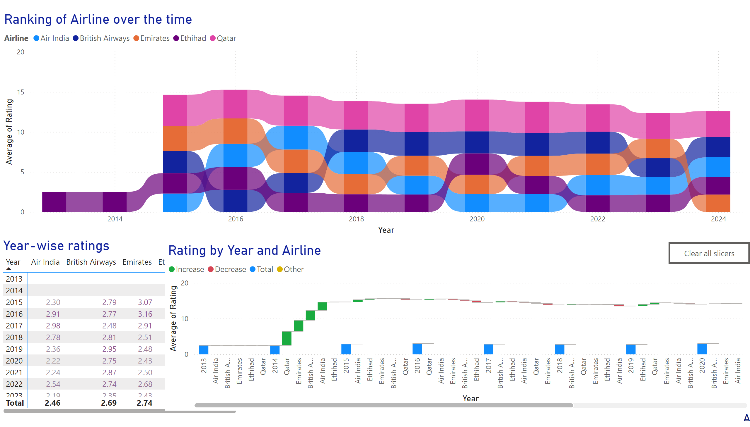
Page 8
Notes:
Ranking of Airline over the time
No alt text provided
Year-wise ratings
No alt text provided
advancedSlicerVisual
No alt text provided
Rating by Year and Airline
No alt text provided
actionButton
No alt text provided

Slide 10
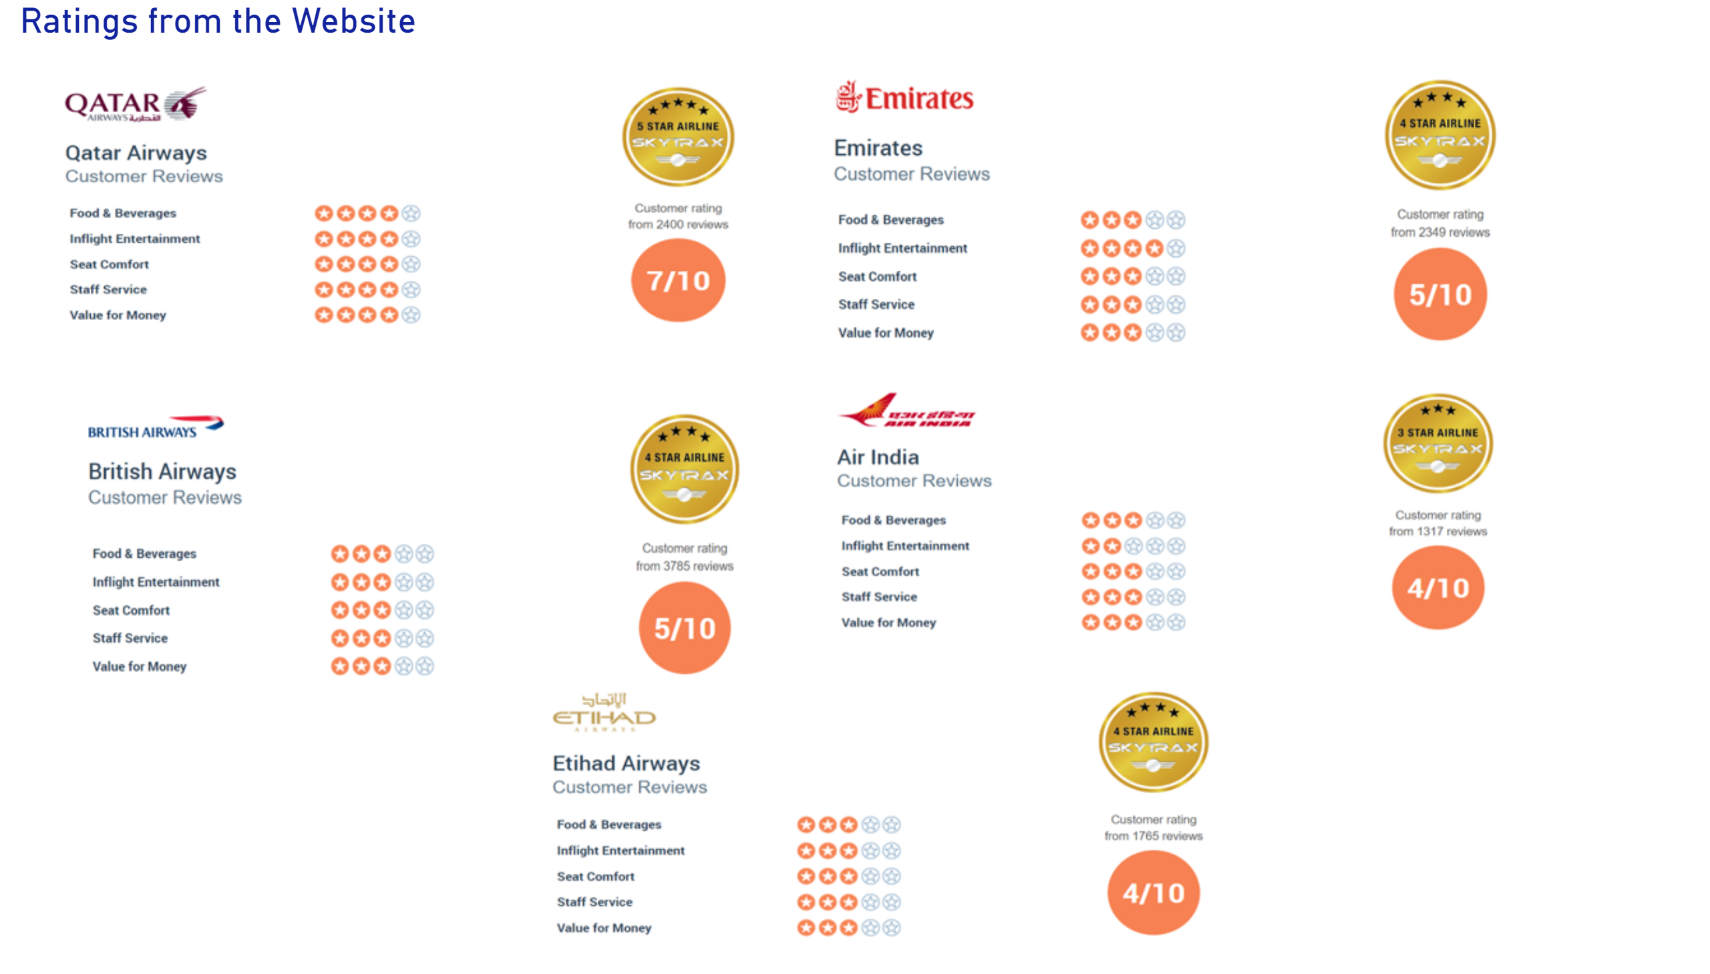
Page 9
Notes:
Ratings from the Website
No alt text provided

